Slide 1
Homework 1
Team 1
Apostolopoulou Ioanna
Toloudis Panagiotis

Slide 2
Client : Send Request
Protocol is Stop and Wait
Wait until Server sends Ack
Start a Ping Pong Communication with Server
Wait until Servers Sends Reply to the Request
Send Ack to inform Server you Received its Reply
Send Next Request from Buffer

Slide 3
Server : Send Reply
Creates Socket for Communication
Assigns an IP Address to Socket by using bind()
Creates the Buffer, that keeps track of Client’s Request
Creates the Threads
  Multicast_thread, PingPong_thread, Receive_thread, Send_thread
Waits until Application Layer processes Requests
Closes the Sockets
Sends Reply to Client and Frees the Allocated Memory

Slide 4
MULTICAST
Use: To Discover Server
Client : Sends Multicast Request for Server’s IP and Port
Server : Replies to Client its IP and Port
Communication Begins
If Buffer.Server is Empty
  Multicast Succeded

Slide 5
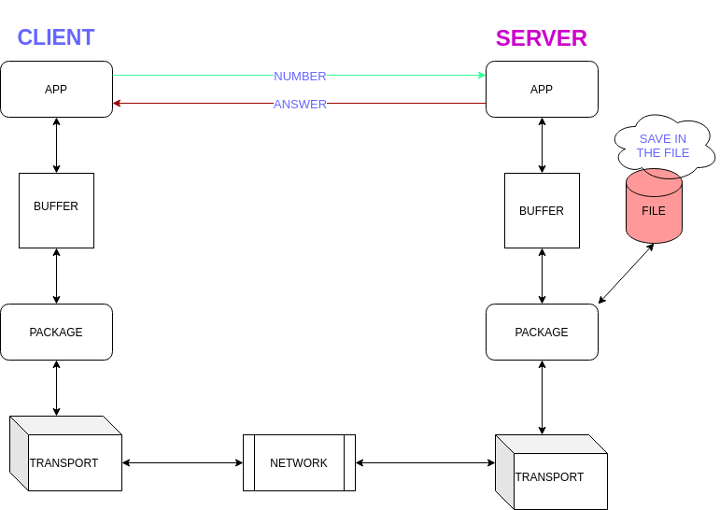
13, 19

Slide 6
13, 19
13, 19

Slide 7
13, 19
13, 19
13, 19

Slide 8
13 , 19
13, 19
13, 19
Multicast

Slide 9
13 , 19
13, 19
13, 19
Multicast

Slide 10
13 , 19
13, 19
13, 19
13

Slide 11
No Service Found
If Client Receives Error from Multicast
  Stops asking for specific Service in Server
  Sends Request for another Service

Slide 12
13 , 19
13, 19
13, 19
0

Slide 13
13 , 19
13, 19
13, 19
0

Slide 14
13 , 19
13, 19
13, 19
0

Slide 15
13 , 19
13, 19
NOT SERVICES 13
13, 19

Slide 16
Service Exists
If Multicast Succeeds
  Client Receives the right IP and Port from Server
  Sends the Requests
  And our Protocol takes over

Slide 17
13 , 19
13, 19
13, 19
1

Slide 18
13 , 19
13, 19
13, 19
1

Slide 19
13 , 19
13, 19
13, 19
1

Slide 20
13 , 19
13, 19
SERVICES 13
13, 19

Slide 21
13 , 19
13, 19
13
13, 19
13, 19

Slide 22
13 , 19
13, 19
13
13, 19
13, 19

Slide 23
13 , 19
13, 19
IP, PORT
13
13, 19
13, 19

Slide 24
13 , 19
13, 19
13, 19
13
13, 19
ACK

Slide 25
13 , 19
13, 19
13, 19
13
13, 19
ACK

Slide 26
13 , 19
19
13, 19
13, 19
13
13, 19
ACK

Slide 27
13 , 19
19
13, 19
13

Slide 28
13 , 19
13, 19
13
1

Slide 29
13 , 19
13, 19
13
1
1

Slide 30
13 , 19
13, 19
13
1

Slide 31
13 , 19
1
1
13, 19
13

Slide 32
Ping-Pong Communication – Server Damage
When Client Receives Ack from Server
Ping Server to know if is Up or Down
When Application Layer of Server Sends the Reply communication is killed
If Ping-Pong fails for over than 20 times
Client believes Server is Down

Slide 33
Server Damage
When Server Receives a Request from Client
Stores the Request into Buffer
Additionally Creates a CSV File in which IP and Port of Client who sent the Request
If Server is Down reads from File the Info of Client and Sends a Message “I was Down Send Request Again” to Client

Slide 34
13 , 19
19
13, 19
13
PING
PONG

Slide 35
13 , 19
13
PING

Slide 36
13 , 19
EXIT

Slide 37
13 , 19
IP,PORT
13
-1
PING

Slide 38
13 , 19
IP,PORT
13
PING
-1
-1

Slide 39
13 , 19
IP,PORT
13
-1

Slide 40
13 , 19
-1
IP,PORT
13

Slide 41
SEND AGAIN
13 , 19
-1
IP,PORT
13

